Slide 1

GRAPHICAL USER INTERFACE (GUI) FOR QUALITY OF MANGOES.
INFROMATION SYSTEM PROJECT
END SEM PRESENTATION
DEPARTMENT OF INDUSTRIAL AND SYSTEMS ENGINEERING
IIT KHARAGPUR
Under The Guidance Of,
Prof. M JENAMANI
And
Mr. SUBHADEEP BARDHAN
( RESEARCH SCHOLAR)
Presented by,
ESLAVATH VINOD KUMAR
21IM60R21

Slide 2
Objectives :
Create GUI for mango quality representation.
Develop a logic for classifying sensor data as different quality parameters.
Implement this logic using real-time sensor data.
Display the mango quality through a GUI.

Slide 3
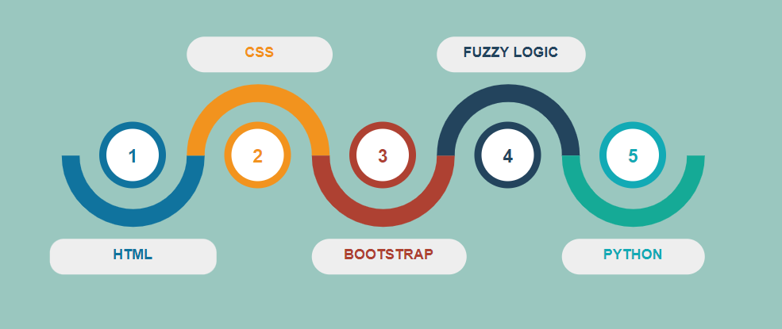
Roadmap for GUI development :

Slide 4
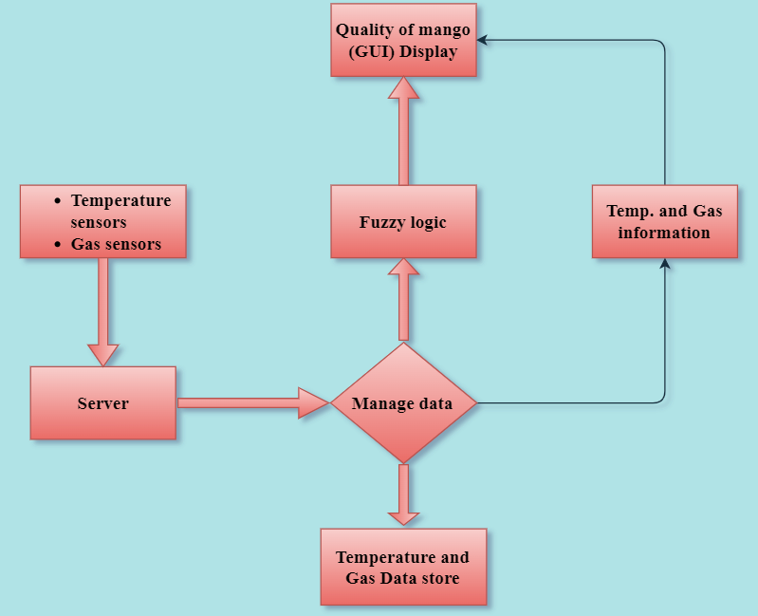
Data flow diagram of the system :

Slide 5
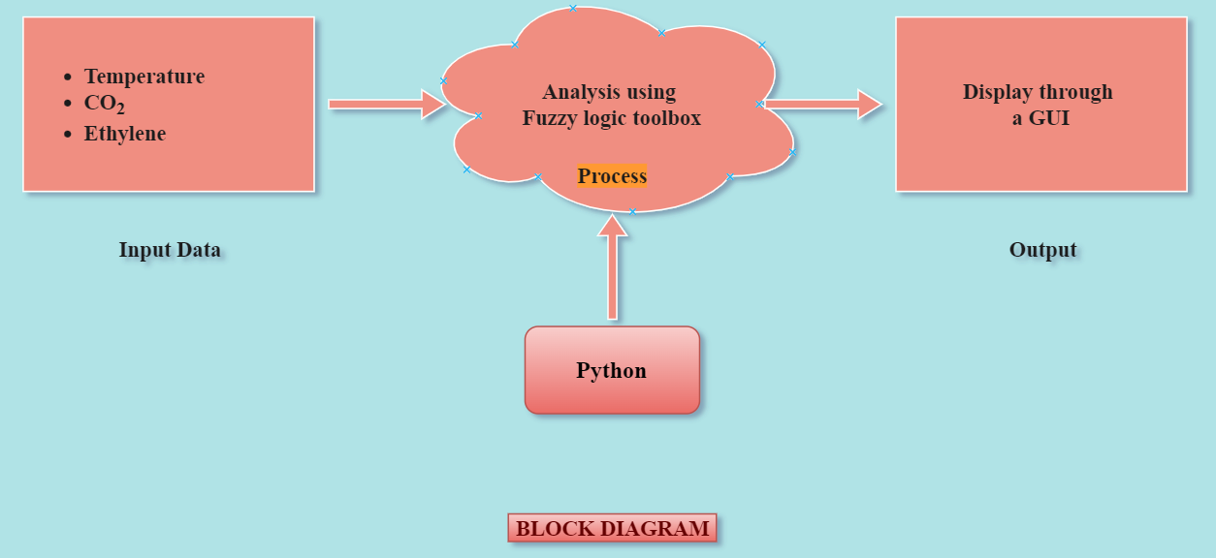
Block diagram of mango quality system :

Slide 6


Software and Packages :

Slide 7
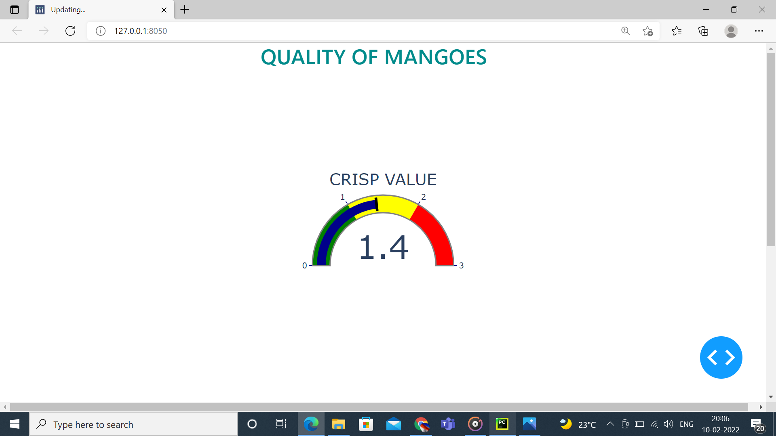
GUI Design by using Python Dash
CRISP VALUE REPRESENTS THE QUALITY OF MANGO
NOT SPOILED
PARTIALLY SPOILED
SPOILED

Slide 8
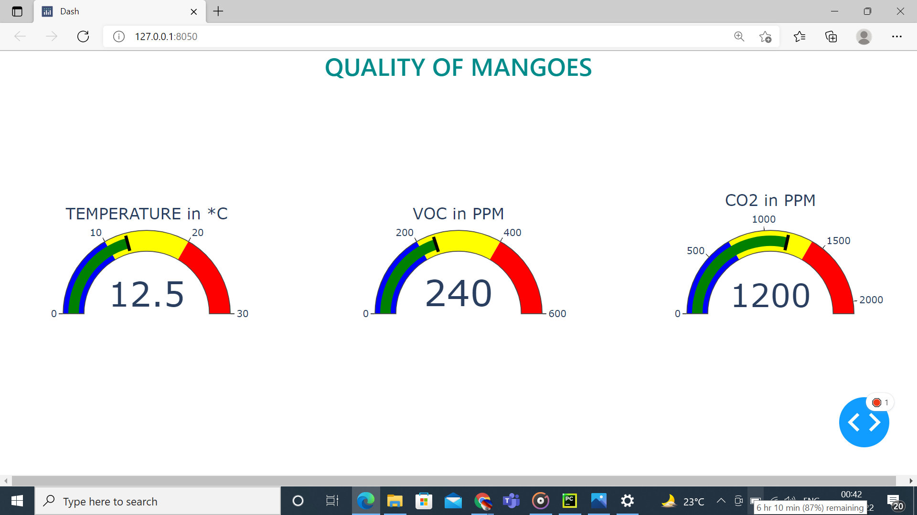
GUI Design by using Python Dash

Slide 9
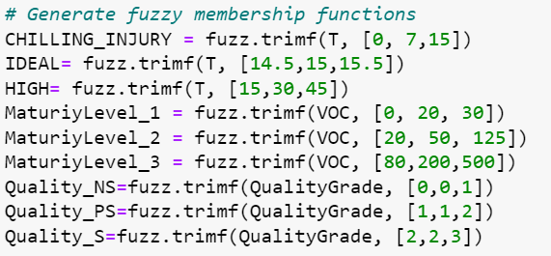
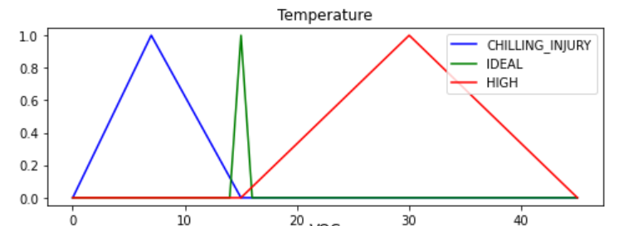
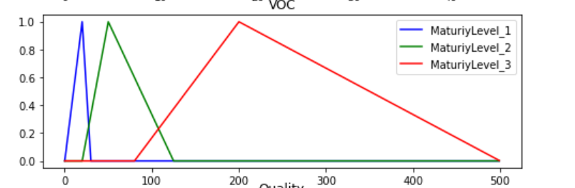
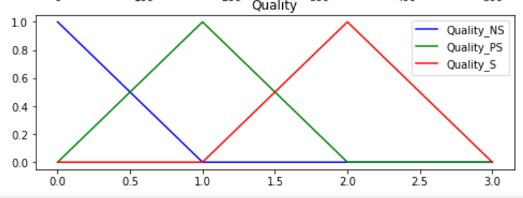
FUZZY LOGIC IMPLIMENTATION

Slide 10
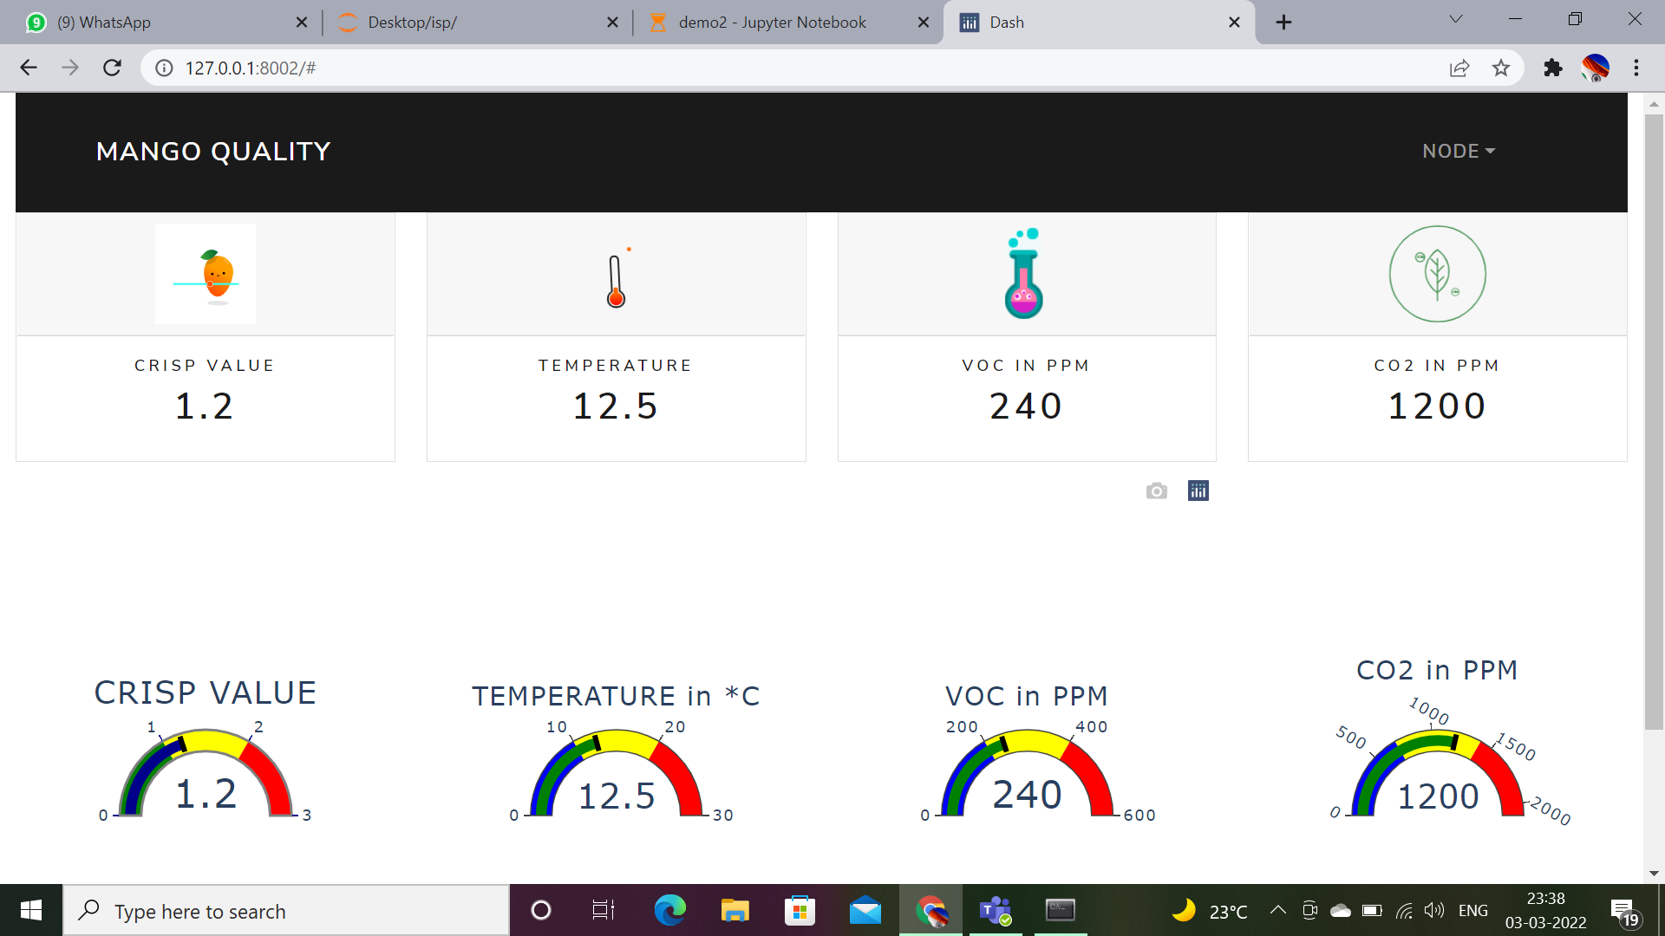
FINAL GUI FOR MANGO QUALITY

Slide 11
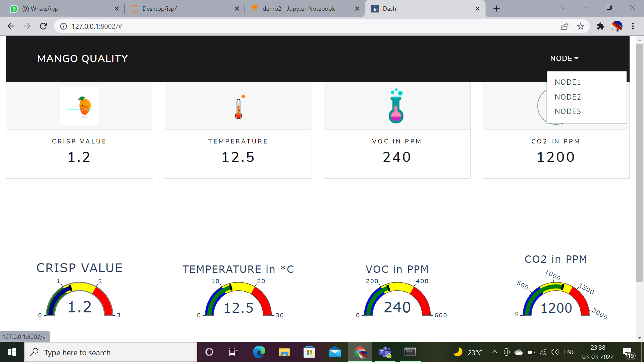
FINAL GUI FOR MANGO QUALITY

Slide 12


